Slide 1
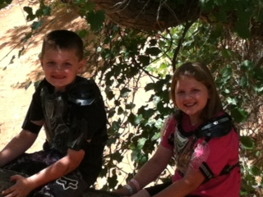
Welcome 6th Grade FACS of Life Mrs. Oliver

Slide 2
Foods Unit 6th Grade FACS –Day 1
Bellwork: What are your favorite things to cook in the kitchen? If you don’t cook much, what things do you make yourself to eat?
Objective: Identify safety and sanitation procedures while working in the kitchen.
CW: Kitchen Safety pre test, begin kitchen safari
HW: Have a great night!

Slide 3
Nine week exploratory class
Personal Growth and Development:
Character Education
Values/Goals
Communication Skills:
Food Preparation
Kitchen Safety and Sanitation
Tools and Equipment
Measuring and Abbreviations
Sewing Skills:
Identifying sewing equipment
Able to thread a sewing machine
Create a sewing project

Slide 4
Class Info.
Absent Work
Work Completed to Cook
Make Up Labs
Class website
Contact Me:
816-224-1700
aoliver@bssd.net
www.oliverfacs.weebly.com

