Slide 1
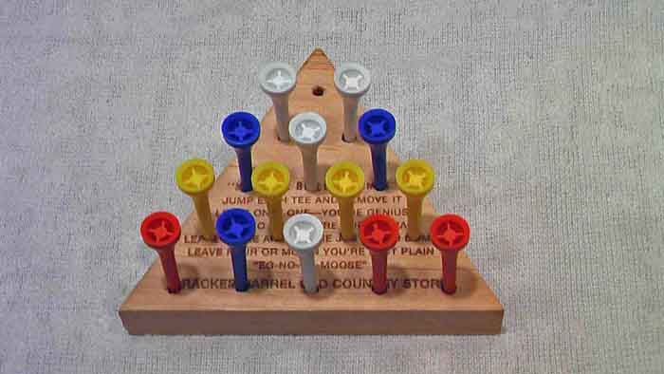
Human Peg Board
http://www.youtube.com/watch?v=yc7yXi50hg4

