Slide 1
Measuring Basics II Class Notes

Slide 2
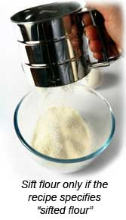
Flour
Flour can be sifted first with a sifter to break up clumps.
Do this only when the recipe calls for sifted flour.
To measure flour correctly, pour the flour into a measuring cup using a spoon and then level it off with a straight edge spatula.

Slide 3
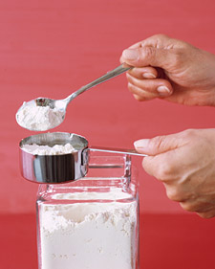
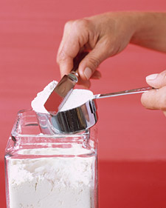

Slide 4
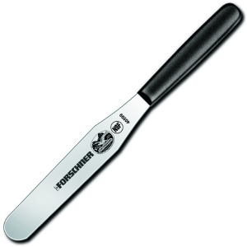
← sifter
(Never ever get a sifter wet. Doing so will ruin it.)
straight edge spatula →

Slide 5
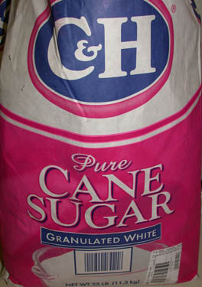
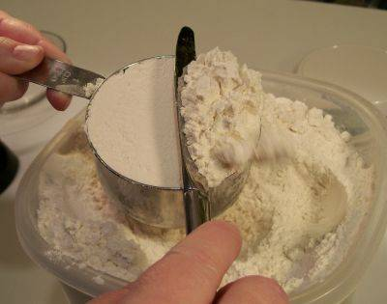
Granulated Sugar
To measure sugar correctly, dip your measuring cup into the container or bag and scoop out the sugar. Then use a straight edge spatula to level off.

Slide 6
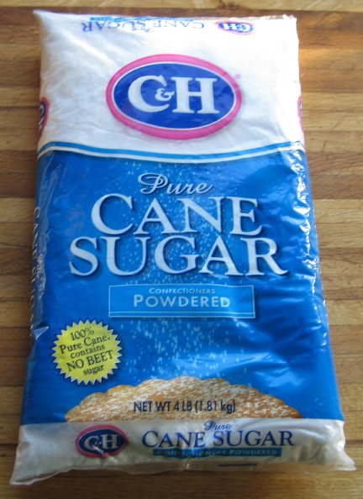
Confectioner’s Sugar
This kind of sugar is also known as powdered sugar. To measure the confectioner’s sugar correctly, remove any clumps by pressing the sugar through a sieve. Then spoon sugar into a dry measuring cup and level it off with a straight edge spatula.

Slide 7
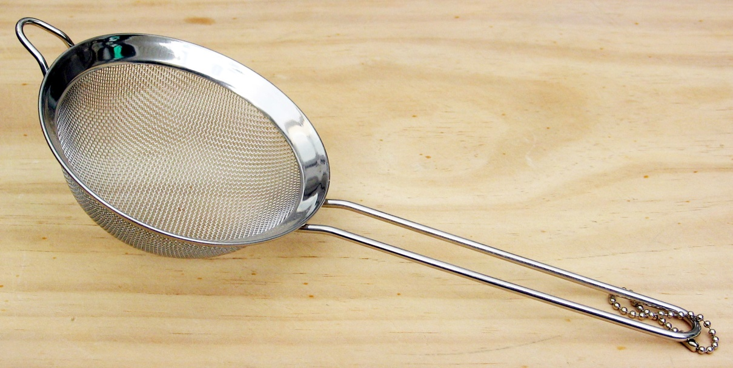
sieve

Slide 8
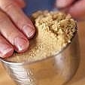
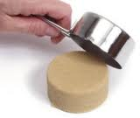
Brown Sugar
To measure brown sugar correctly, you need to pack it down into a dry measuring cup and then level it off using a straight edge spatula.

Slide 9
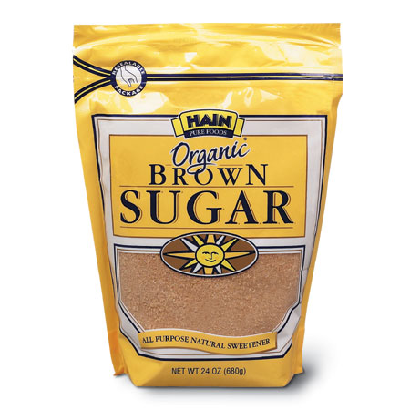
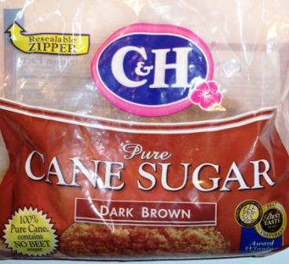

Slide 10
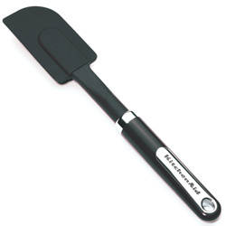
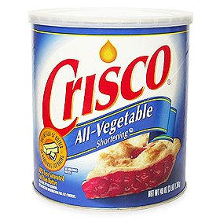
Shortening
Shortening is a solid vegetable oil. To measure shortening correctly, pack it into a dry measuring cup and then level it off with a straight edge spatula. Using a rubber spatula will help.
Rubber spatula
Shortening

Slide 11
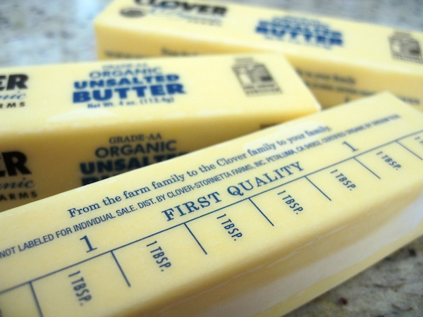
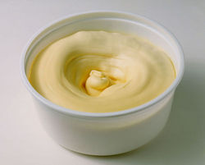
Margarine
On a stick of margarine and butter there are tick marks which divide the stick butter into tablespoons. When measuring margarine or butter, use the tick marks as a guide. If it’s in a tub, spoon the margarine into a dry measuring cup, pack it down and level it off.

Slide 12
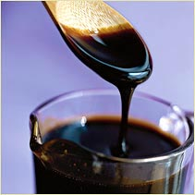
Molasses
Pour the molasses into a liquid measuring cup and remove it with a rubber spatula.

Slide 13
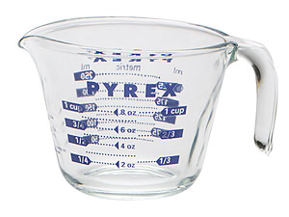
Liquid measuring cup
Rubber spatula/rubber scraper

Slide 14
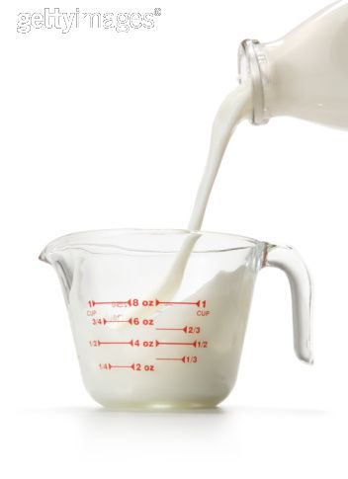
Milk
Pour the milk into a liquid measuring cup and then check
it at eye level. When doing this, make sure you place the
cup on a flat surface, like a table.

Slide 15
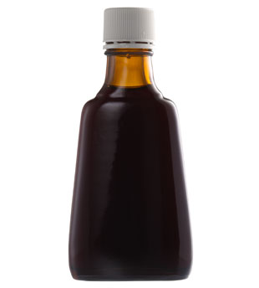
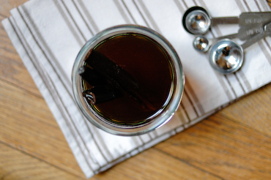
Vanilla
Pour the vanilla into a measuring spoon. To help
from spilling, pour over a small bowl to catch any
excess.

Slide 16
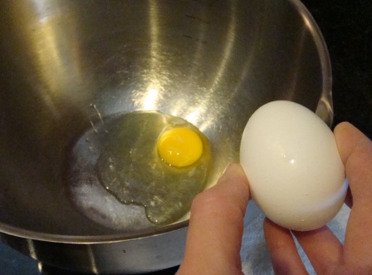
One-half egg
Beat a whole egg in a bowl with a fork. Then
measure out two tablespoonfuls of egg.

