Slide 1
Small Equipment Identification

Slide 2
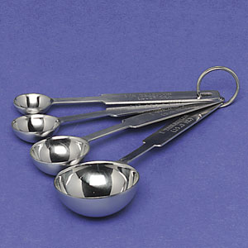
Measuring Spoon

Slide 3
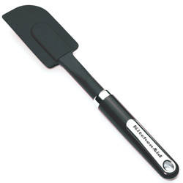
Rubber Scraper / Spatula

Slide 4
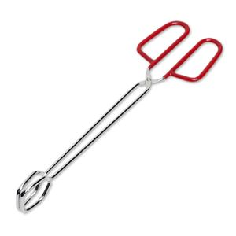
Tongs

Slide 5
Vegetable Peeler

Slide 6
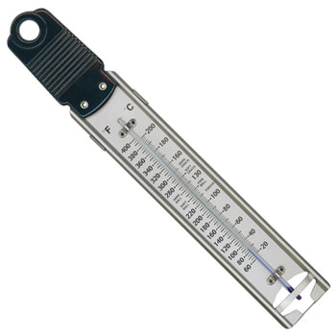
Candy Thermometer

Slide 7
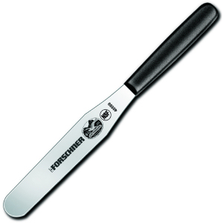
Straight Edge Spatula

Slide 8
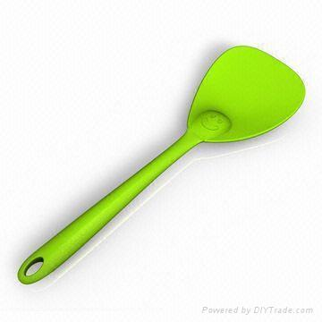
Spatula

Slide 9
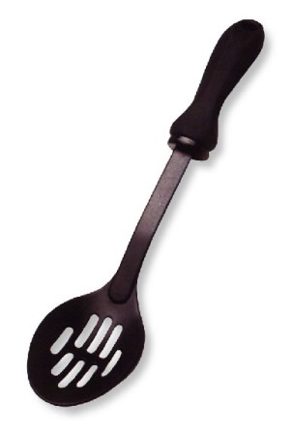
Slotted Spoon

Slide 10
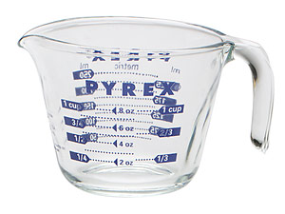
Liquid Measuring Cup

Slide 11
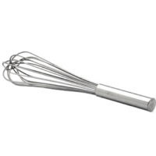
Wisk

Slide 12
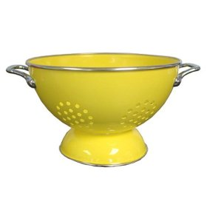
Colander

Slide 13
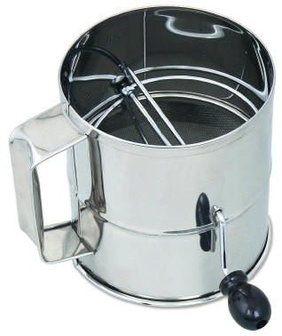
Sifter

Slide 14
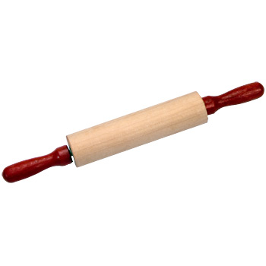
Rolling Pin

Slide 15
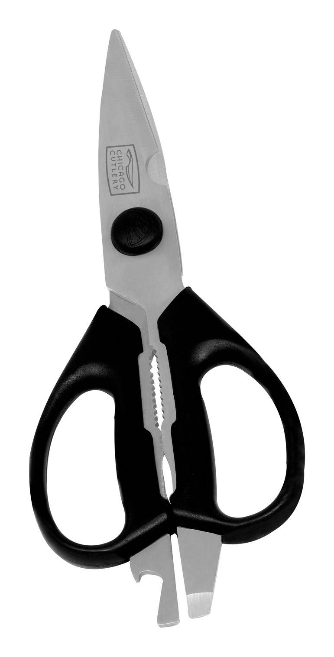
Kitchen Scissors / Shears

Slide 16
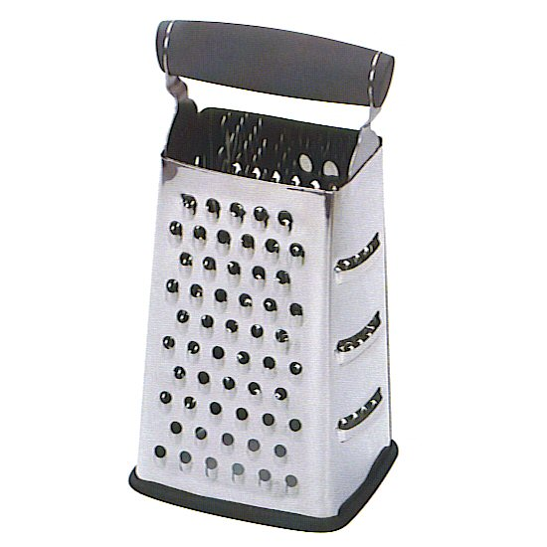
Grater

Slide 17
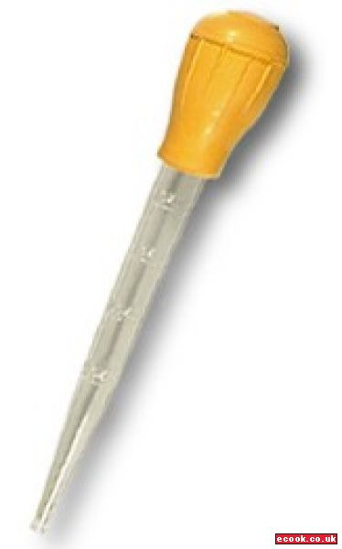
Baster

Slide 18
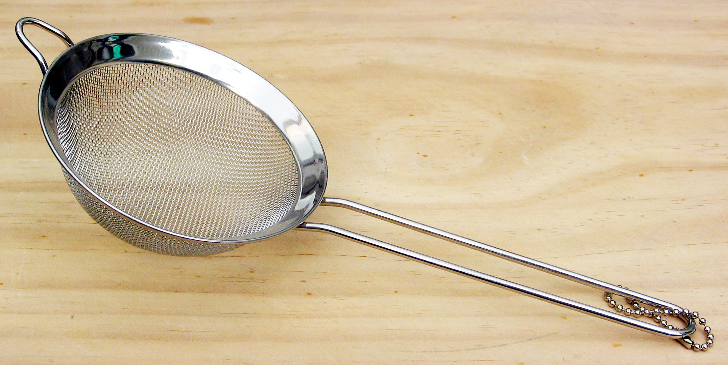
Sieve

Slide 19
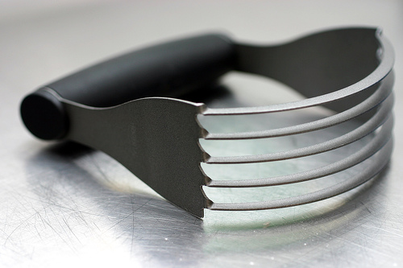
Pastry Cutter

Slide 20
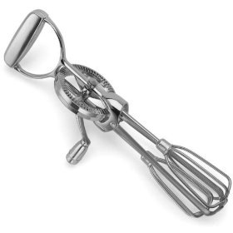
Rotary Beater

Slide 21
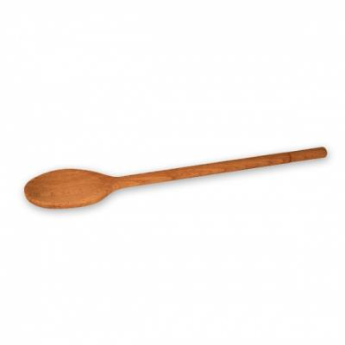
Cooking Spoon

Slide 22
3 Tined Fork

Slide 23
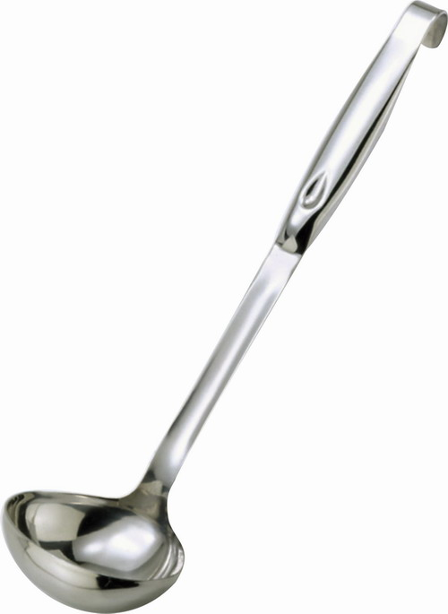
Ladle

Slide 24
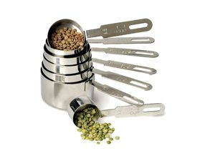
Dry Measuring Cups

Slide 25
Cutting Board

Slide 26
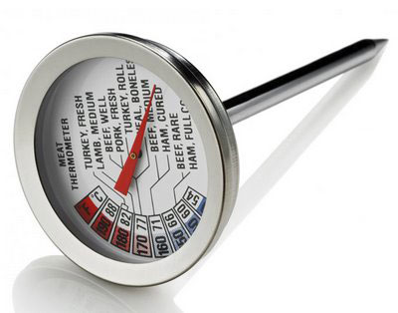
Meat Thermometer

Slide 27
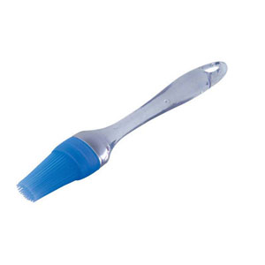
Pastry Brush

Slide 28
Paring Knife

Slide 29
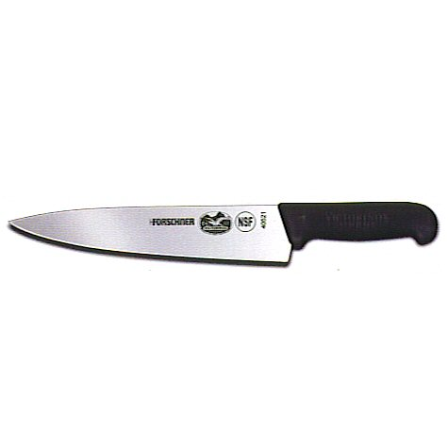
French Knife / chef’s Knife

Slide 30
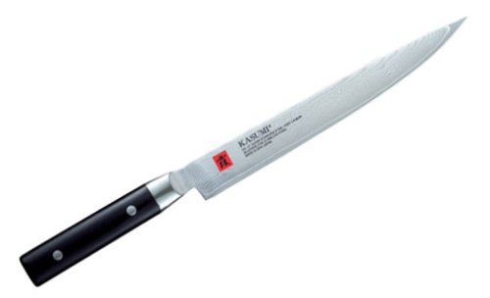
Slicing Knife

Slide 31
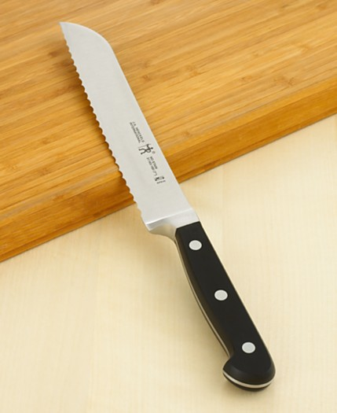
Bread Knife

